Slide 1
Modified SEIR and AI prediction of the epidemics trend of COVID-19 in China under public health interventions
Gwangwoo Kim
Jan. 20, 2023

Slide 2

Summary

Slide 3
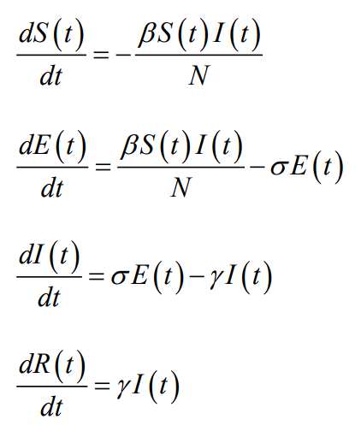
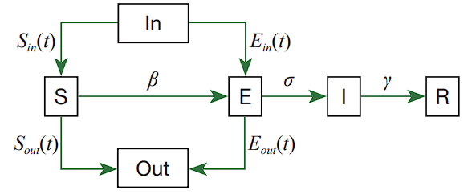
Modified SEIR model

Slide 4
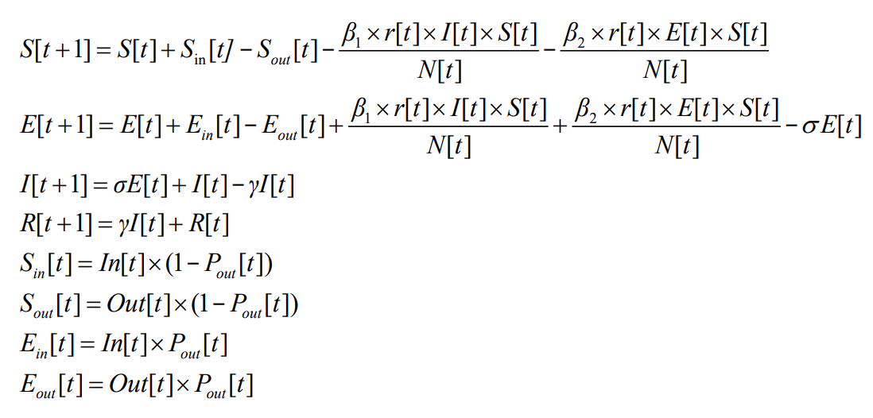

Modified SEIR model

Slide 5

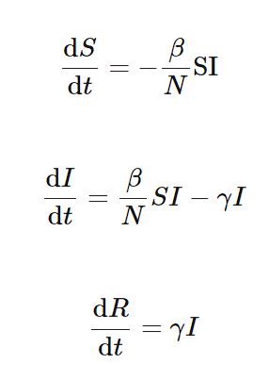
Estimation of model parameters

Slide 6
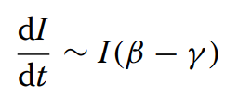
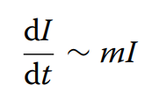



Estimation of model parameters

Slide 7
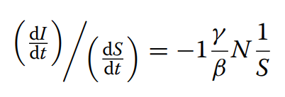
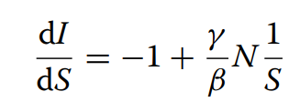

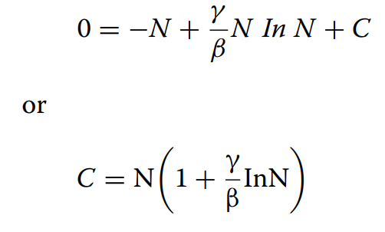
Estimation of model parameters

Slide 8

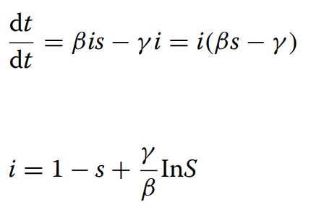


Estimation of model parameters

Slide 9

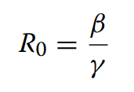

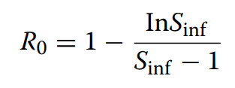
Estimation of model parameters

Slide 10


Estimation of model parameters

Slide 11
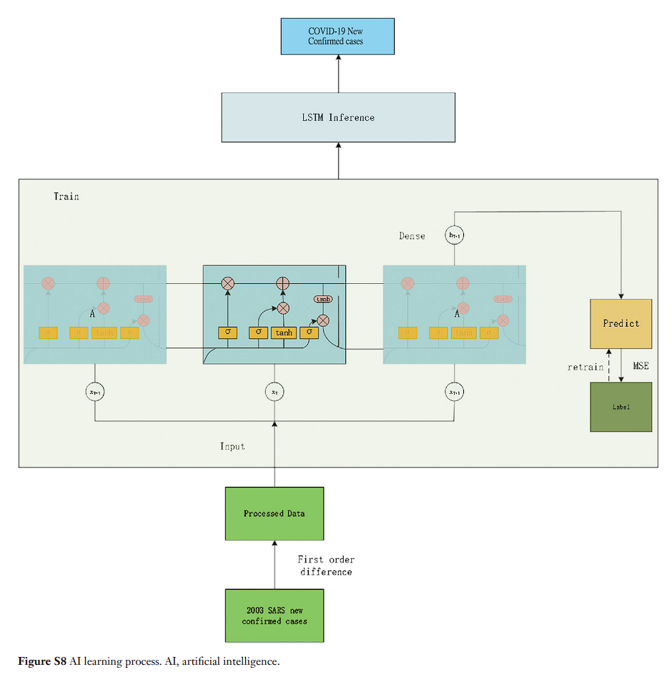
Estimation of model parameters

Slide 12
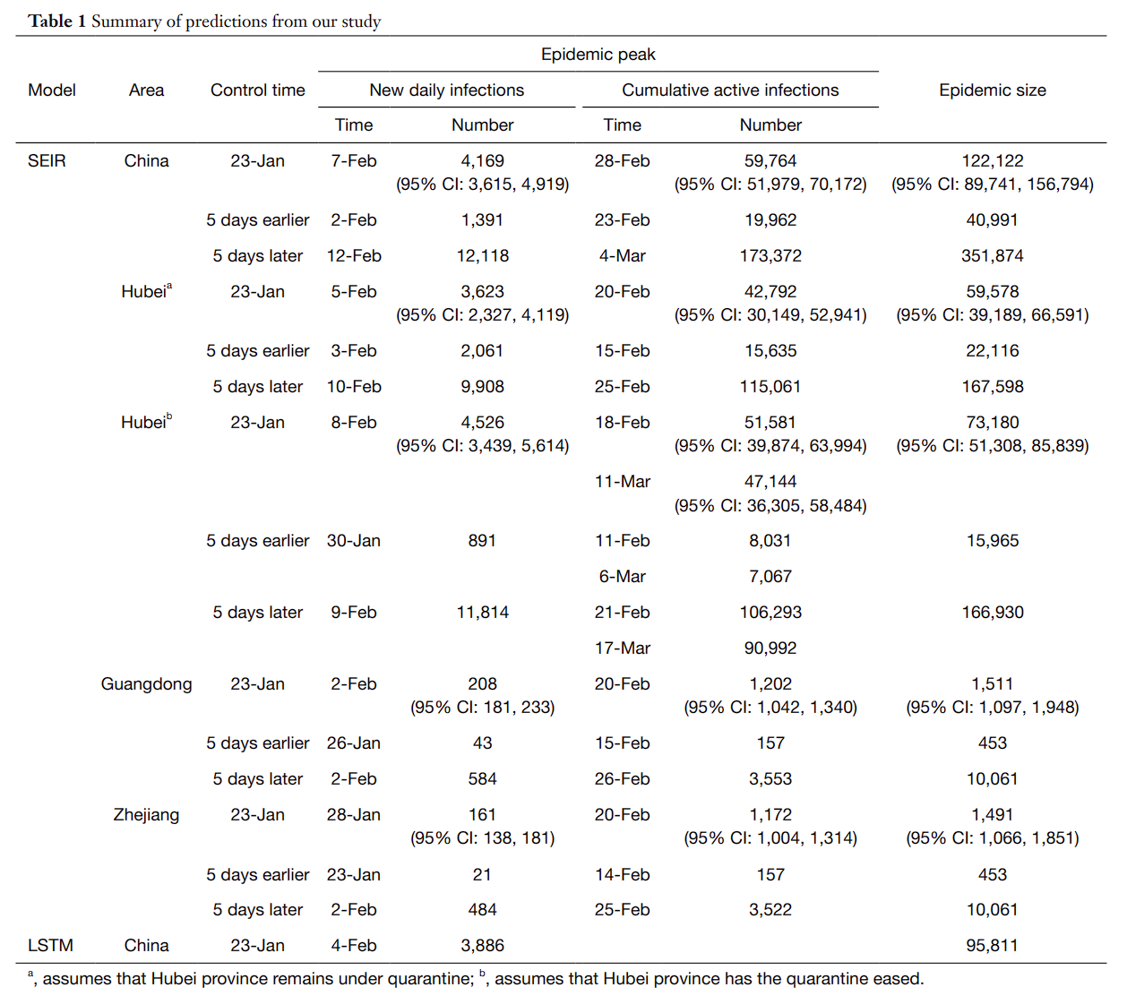
Results

Slide 13
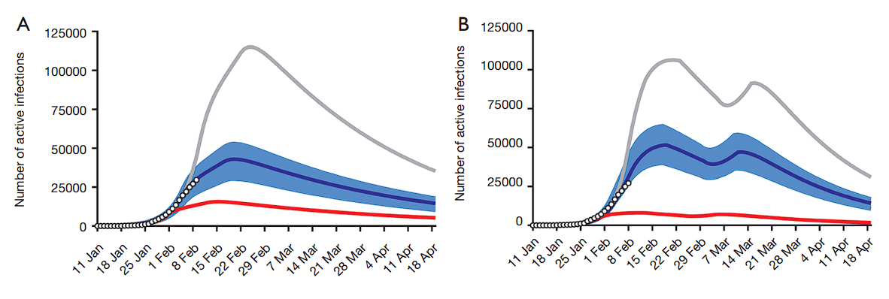

Results

Slide 14
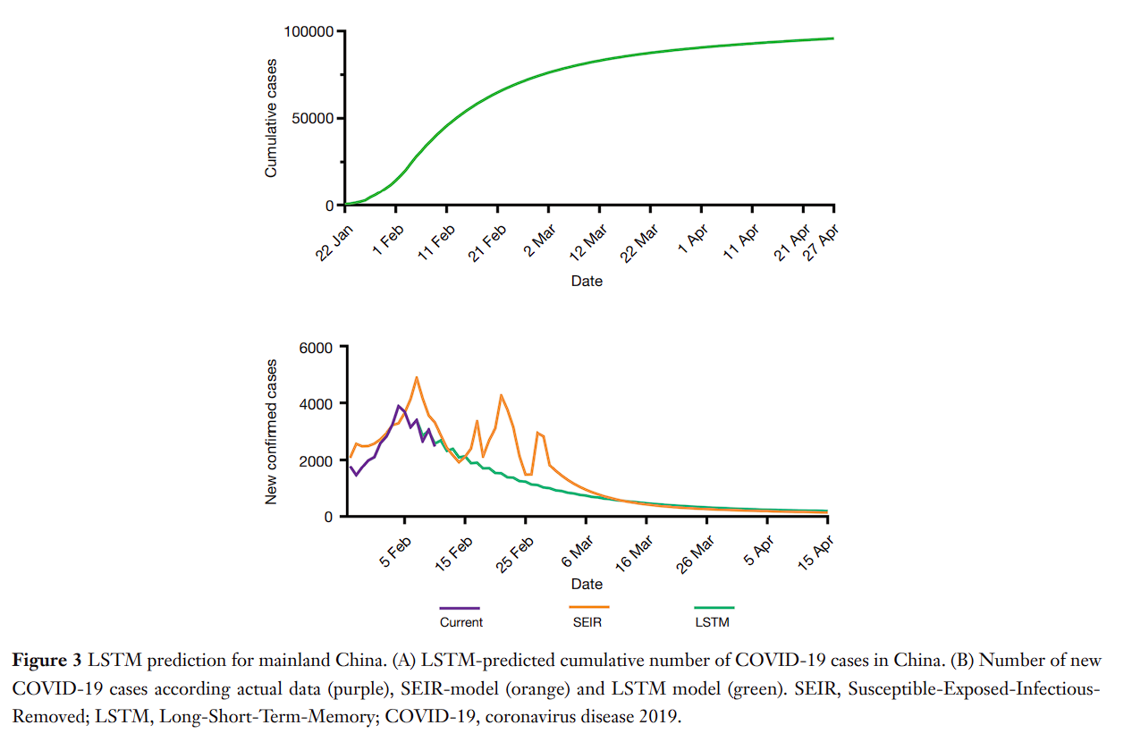
Results

Slide 15
Remarks
Quicker enforcement of control measures is important.
Consider an influx of new susceptible individuals.
The policy of strict monitoring should remain in place until the end of April 2020.

